Slide 1
Broadcasting, Multicasting and Geo-casting

Slide 2
Introduction
The Broadcast Storm
Doing network-wide broadcasting in ad hoc networks requires one device to broadcast the information to all its neighbors.
For far-away devices, the message is rebroadcasted which could cause collision if multiple device broadcasts the same time and are in the neighborhood.
This is also known as the broadcasting storm problem [Nil999] and in this section we discuss ways to perform efficient rebroadcasting of messages.

Slide 3
For the purpose of our discussion here, we assume that MHs in the MANET share a single common channel with carrier sense multiple access (CSMA) [Agrawal2002], but no collision detection (CD) capability.
Synchronization in such a network with mobility is unlikely, and global network topology information is unavailable to facilitate the scheduling of a broadcast.
Thus, one straightforward and obvious solution is to achieve broadcasting by flooding (for example, as it is done by mostly all MANET routing algorithms).
Unfortunately, as we will see later, it is observed that redundancy, contention, and collision could exist if flooding is done blindly. Several problems arise in these situations including:

Slide 4
• As the radio propagation is omnidirectional and a physical location may be covered by the transmission ranges of several hosts, many rebroadcasts are considered to be redundant;
• Heavy contention could exist because rebroadcasting hosts are probably close to each other; and
• As the RTS/CTS handshake is inapplicable for broadcast transmissions, collisions are more likely to occur as the timing of rebroadcasts is highly correlated.

Slide 5
Broadcasting in a MANET
A MANET consists of a set of MHs that may communicate with one another from time to time, and where no base stations are present.
Each host is equipped with a CSMA/CA (carrier sense multiple access with collision avoidance) [Agrawal2002] transceiver.
In such an environment, a MH may communicate with each other directly or indirectly.
In the latter case, a multi-hop scenario occurs, where the packets originated from the source host are relayed by several intermediate MHs before reaching the destination.
The broadcast problem refers to the transmission of a message to all other MHs in the network. The problem we consider has the following characteristics.

Slide 6
• The broadcast is spontaneous: Any MH can issue a broadcast operation at any time. For reasons such as the MH mobility and the lack of synchronization, preparing any kind of global topology knowledge is prohibitive (in fact, this is at least as hard as the broadcast problem). Little or no local information may be collected in advance.
• The broadcast is frequently unreliable: Acknowledgement mechanism is rarely used. However, attempt should be made to distribute a broadcast message to as many MHs as possible without putting too much effort.
The motivations for such an assumption are:
A MH may miss a broadcast message because it is off-line, it is temporarily isolated from the network, or it experiences repetitive collisions;
Acknowledgements may cause serious medium contention (and thus another "storm") surrounding the sender; and
In many applications (e.g., route discovery in ad hoc routing protocols), a 100% reliable broadcast is unnecessary.

Slide 7
In addition, we assume that a MH can detect duplicate broadcast messages, as this is essential to prevent endless flooding of a message.
One way to do so is to associate a tuple (source ID, sequence number) with each broadcast message as in the case of DSR and AODV.
we focus on the flooding behavior in a MANET - the phenomenon where the transmission of a packet will trigger other surrounding MHs to transmit the same (or modified) packet.
We shall show that if flooding is used blindly, many redundant messages will be sent and serious contention/collision will be incurred.

Slide 8
Flooding-Generated Broadcast Storm
A straightforward approach to perform broadcast is by flooding. A MH, on receiving a broadcast message for the first time, has the obligation to rebroadcast the message. Clearly, this costs n transmissions in a network of n MHs. In a CSMA/CA network, drawbacks of flooding include:
•Redundant rebroadcasts: When a MH decides to rebroadcast a broadcast message to its neighbors, all its neighbors already have the message;
•Contention: After a MH broadcasts a message, if many of its neighbors decide to rebroadcast the message, these transmissions (which are all from nearby MHs) may severely contend with each other;
• Collision: Because of the deficiency of backoff mechanism, the lack of RTS/CTS handshake in broadcasts, and the absence of collision detection (CD), collisions are more likely to occur and cause more damage.

Slide 9
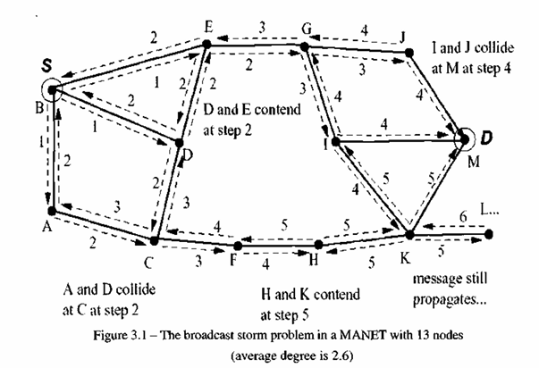
As we have mentioned before, the collection of these drawbacks is referred to as the broadcast storm problem.
Figure 3.1 exemplifies the broadcast storm problem, where node S initiates a route request to node D through a flooding.
As we can see, flooding is highly redundant. Each node receives the route request degree times, and the route request propagates far beyond node D.
Because nearby nodes will receive and rebroadcast the route request at nearly the same time, contention (when senders can hear each other) and collision (when senders cannot hear each other) will be common.

Slide 10
Redundancy Analysis
The main reason for redundancy is that radio signals from different transceivers may negatively overlap with each other.
Let us consider two examples to illustrate the effects of redundancy, where we denote node S is the source of the broadcast and node D as the "last" node to receive the broadcast.
In Figure 3.2(a), it only takes two transmissions for node D to broadcast a message whereas four transmissions will be carried out if no attempt is made to reduce this redundancy.
Figure 3.2(b) presents a more serious scenario where only two transmissions are sufficient to complete a broadcast as opposed to a total of seven transmissions generated if flooding is blindly used.

Slide 11
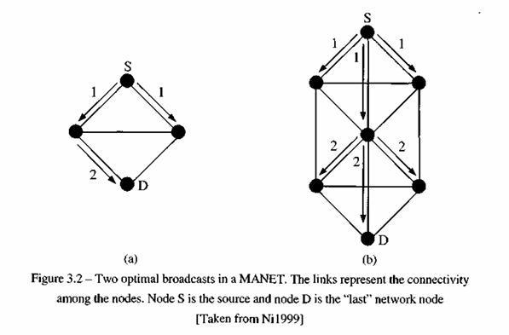

Slide 12
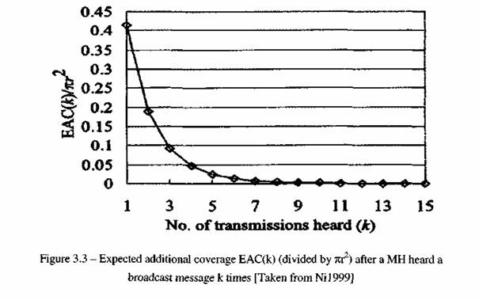
Let EAC(k) denote the expected additional coverage provided by a host's rebroadcast after the host has heard the same broadcast packet k times.
Figure 3.3 shows the simulation results obtained from [Nil999] where we can observe that for values of k greater than 3, the expected additional coverage is below 5%. Therefore, ways to control rebroadcasts are of paramount importance, and we provide an overview of the main ones in the following sections.

Slide 13
Rebroadcasting Schemes
Recently, there have been many proposals to address the broadcast storm problem.
Typically, these techniques aim at minimizing the number of retransmissions of a broadcast message while, at the same time, attempting to ensure that a broadcast packet is delivered to each and every node in the network.
Before delving into the proposed solutions, it is important however to introduce common attributes of mostly all broadcast protocols considered here.
We also note that many (or even all) of the protocols proposed to date usually assume the IEEE standard 802.11 as the MAC layer. Therefore, we confine our discussion to the broadcasting schemes only.

Slide 14
Common Characteristics
Design Considerations: Jitter and RDT
As we know, radio waves propagate at the speed of light. Therefore, if we assume that a source node transmits a broadcast packet, all of the source's neighbors will receive the transmission nearly at the same time. If we further assume that all nodes possess similar hardware and system loads, the neighbors will process the packet and rebroadcast it approximately at the same time, thereby causing packet collisions.
To address this problem, broadcast protocols jitter the scheduling of broadcast packets from the network layer down to the MAC layer by some random amount of time.
This jitter allows one neighbor to acquire the channel first, while other neighbors detect that the channel is busy.
Many of the broadcasting protocols require a node to keep track of redundant packets received over a short time interval in order to determine whether or not to rebroadcast. This time interval, which is called as Random Delay Timer (RDT), is randomly chosen from a uniform distribution and accomplishes two things.
First, it allows nodes sufficient time to receive redundant packets and conduct an evaluation. Second, the randomized scheduling mitigates packet collisions as discussed earlier.

Slide 15
An important design consideration in any broadcast protocol is the implementation of the random assessment delay.
One approach is to send broadcast packets to the MAC layer after a short random time similar to the jitter. In this case, packets remain in the interface queue until the channel becomes clear for broadcast.
While the packet is in the interface queue, redundant packets may be received, allowing the network layer to determine if rebroadcasting is still required. If the network layer protocol decides the packet should not be rebroadcast, it informs the MAC layer to discard the corresponding packet.
A second approach is to implement the random assessment delay as a longer time period and keep the packet at the network layer until the RDT expires.
Retransmission assessment is done considering all redundant packets during the RDT. After RDT expiration, the packet is either sent to the MAC layer or dropped.
In this scheme, no attempts are made by the network layer to remove the packet after sending it to the MAC layer.

Slide 16
Loop Prevention
None of the protocols discussed here require that a node rebroadcast a given packet more than one time.
Thus, each broadcast protocol requires that nodes cache the original source node ID of the packet and the packet ID.
This allows the protocol to uniquely identify each broadcast packet and assign appropriate behavior upon reception of another broadcast packet.

Slide 17
Categories and Protocols
We now cover the broadcasting protocols for MANETs by categorizing them into the following classes with increasing complexity:
• Simple flooding;
• Probability-based methods;
• Area-based methods; and
• Neighbor knowledge methods.
Simple flooding requires each node to rebroadcast all packets.
Probability-based methods use some basic understanding of the network topology to assign a probability to a node to rebroadcast.
Area-based methods assume nodes have common transmission distances; and a node will only rebroadcast a packet if this rebroadcast will likely provide sufficient additional coverage area.
Neighbor knowledge methods maintain state on their neighborhood, via hello packets, which is used in making the decision about rebroadcast.

Slide 18
Simple Flooding
The algorithm for simple flooding [Ho 1999, Jetcheva2001] starts off with a source node broadcasting a packet to all neighbors.
The neighbors, upon receiving the broadcast packet, rebroadcast the packet exactly once and this continues until all reachable network nodes have received and rebroadcast the packet at least once (assuming reliability).
Flooding is proposed as a scheme to achieve reliable broadcast and also multicast in highly dynamic networks in [Ho 1999].

Slide 19
Probability-Based Methods
Probabilistic Scheme
The probabilistic scheme [Nil999] is similar to ordinary flooding, except that nodes only rebroadcast with a predetermined probability.
In dense networks, it is much likely that multiple nodes share similar transmission coverage. Thus, having some random nodes not to rebroadcast saves network resources without harming packet delivery effectiveness.
In sparse networks, there is much less shared coverage and, therefore, not all nodes will receive all the broadcast packets with this scheme unless the probability parameter is high. When the probability is 100%, this scheme is identical to ordinary flooding.

Slide 20
Counter-Based Scheme
An inverse relationship is shown [Nil999] between the number of times a packet is received at a node and the probability of this node's transmission being able to cover additional area on a rebroadcast.
This result forms the basis of the counter-based scheme. Upon receipt of a previously unseen packet, the node initiates a counter with a value of one and sets a RDT.
During the RDT, the counter is incremented by one for each redundant packet received. If the counter is less than a threshold value when the RDT expires, the packet is rebroadcast. Otherwise, it is simply dropped.
Results reported in [Nil999] show that threshold values above six relate to little additional coverage area being reached.
The overriding features of the counter-based scheme are its simplicity and its inherent adaptability to local topologies.
In other words, in a dense area of the network some nodes will not rebroadcast, whereas in sparse areas of the network all nodes will likely rebroadcast.

Slide 21
Area-Based Methods
Suppose a node receives a packet from a sender that is located only one meter away. If the receiving node rebroadcasts, the additional area covered by the retransmission is quite low.
On the other hand, if a node is located at the boundary of the sender's radio coverage, then a rebroadcast would provide significant additional coverage area (to be more precise, up to 61% as we have seen earlier).
A node using an area based method can try to estimate the additional coverage area based on all received redundant transmissions.
We note that area-based methods only consider the coverage area of a transmission; while they do not consider the presence of nodes within this area.

Slide 22
Distance-Based Scheme
A node using the distance-based scheme compares the distance (e.g., through received signal strength indicator) between itself and each of its neighbor nodes that has previously rebroadcast a given packet.
Upon reception of a previously unseen packet, a RDT is initiated and redundant packets are cached.
When the RDT expires, all source node locations are examined to determine if the distance between itself and any of its neighbor nodes is closer than a threshold distance value. If true, the node does not rebroadcast.

Slide 23
Location-Based Scheme
In this method, each node must have the means to determine its own location (e.g., through GPS).
Whenever a node originates or rebroadcasts a packet, it adds its own location to the header of the packet.
When a node initially receives a packet, it notes the location of the sender and calculates the additional coverage area obtainable were it to rebroadcast.
If the additional area is less than a threshold value, the node does not rebroadcast and all future receptions of the same packet are ignored.
Otherwise, the node assigns a RDT before transmission. If the node receives a redundant packet during the RDT, it recalculates the additional coverage area and compares that value with the threshold.
The area calculation and threshold comparison occur with all redundant broadcasts received, until the packet reaches its scheduled send time, or else it is dropped.

Slide 24
Neighbour Knowledge Methods
Flooding with Self Pruning
The simplest form of the neighbor knowledge methods is referred to as flooding with self pruning [Lim2000].
This protocol requires that each node have knowledge of its one-hop neighbors, which is obtained via periodic hello packets.
A node includes its list of known neighbors in the header of each broadcast packet. A node upon receiving a broadcast packet compares its neighbor list to the sender's neighbor list.
If the receiving node would not reach any additional nodes, it refrains from rebroadcasting the packet. Otherwise, the node rebroadcasts the packet.

Slide 25
Scalable Broadcast Algorithm (SBA)
The Scalable Broadcast Algorithm (SBA) [Peng2000] requires that all nodes have knowledge of their neighbors within a two-hop radius.
This neighbor knowledge coupled with the identity of the node from which a packet is received, allows a receiving node to determine if it would reach additional nodes by rebroadcasting.
Two-hop neighbor knowledge is achievable via periodic hello packets; where each hello packet contains the source node's identifier (IP address) and the list of known neighbors.
suppose a node B receives a broadcast data packet from node A. Since node A is a neighbor, node B can easily determine all the nodes which are simultaneously neighbor to both nodes A and B.
This is done by comparing the list of neighbors of node A contained in the broadcast packet, with node B's neighbor list.
If node B determines that its broadcast will cover additional neighbors not reached by node A's broadcast, node B schedules the packet for transmission with a RDT. If, in the meantime, node B receives a redundant broadcast packet from any another neighbor, node B again determines if it can reach any new nodes by rebroadcasting.

Slide 26

This process continues until either the RDT expires and the packet is sent, or the packet is dropped.
A method to dynamically adjust the RDT to network conditions is proposed in [Peng2000], where the RDT is calculated based on a node's relative neighbor degree.
Specifically, each node searches its neighbor tables for the maximum neighbor degree of any neighbor node, say, dNmax, which can be obtained from the neighbors' broadcast packets. It then calculates a RDT based on the ratio of.
where dme is the number of current neighbors for the node.
We note that this weighing scheme is greedy, as nodes with the largest number of neighbors usually broadcast before the others (smaller RDT).

Slide 27
Dominant Pruning
Dominant pruning also uses two-hop neighbor knowledge, obtained via hello packets, for routing decisions [Lim2000].
Unlike SBA, however, dominant pruning requires rebroadcasting nodes to proactively choose some or all of its one-hop neighbors as rebroadcasting nodes.
Whenever a node receives a broadcast packet, it checks the header to see if its address is a part of the list. If so, it now has to determine which of its neighbors should rebroadcast its packet so as to include them in the packet header.
For that, it uses a Greedy Set Cover algorithm given the knowledge of which neighbors have already been covered by the sender's broadcast.
One such algorithm [Lim2000] recursively chooses one-hop neighbors that cover all of two-hop neighbors.

Slide 28
Multipoint Relaying
Multipoint relaying [Qayyum2000] is similar to Dominant Pruning in that rebroadcasting nodes are explicitly chosen by upstream senders.
For example, say node A originates a broadcast packet. It has previously selected some, or in certain cases, all of its one-hop neighbors to rebroadcast all packets they receive from node A. The chosen nodes are called Multipoint Relays (MPRs) and each MPR is required to choose a subset of its one-hop neighbors as MPRs.
The following algorithm for a node to choose its MPRs is suggested in [Qayyum2000]:
Find all two-hop neighbors that can only be reached by one one-hop neighbor. Assign those one-hop neighbors as MPRs;
Determine the resultant cover set (i.e., the set of two-hop neighbors that will receive the packet from the current MPR set);
From the remaining one-hop neighbors not yet in the MPR set, find the one that would cover the most two-hop neighbors not in the cover set; and
Repeat from step 2 until all two-hop neighbors are covered.
Multipoint relaying is described in detail as part of the OLSR protocol. In OLSR, hello packets include fields for a node to list the MPRs it has chosen. Clearly, the update interval for hello packets must be carefully chosen and, if possible, optimized for given network conditions.

Slide 29
Ad Hoc Broadcast Protocol
The Ad Hoc Broadcast Protocol (AHBP) [Peng2002] utilizes an approach similar to Multipoint Relaying by designating nodes as a Broadcast Relay Gateway (BRG) within a broadcast packet header.
BRGs are proactively chosen from each upstream sender which is a BRG itself. AHBP differs from Multipoint Relaying in three ways:
1. A node using AHBP informs one-hop neighbors of the BRG designation by a field in the header of each broadcast packet. This allows a node to calculate the most effective BRG set at the time a broadcast packet is transmitted. In contrast, Multipoint Relaying informs one-hop neighbors of the MPR designation via hello packets;
2. In AHBP, when a node receives a broadcast packet and is listed as a BRG, the node uses two-hop neighbor knowledge to determine which neighbors also received the broadcast packet in the same transmission. These neighbors are considered already "covered" and are removed from the neighbor graph used to choose next hop BRGs. In contrast, MPRs are not chosen considering the source route of the broadcast packet;
3. AHBP is extended to account for high mobility networks. Suppose node A receives a broadcast packet from node B, and node A does not list node B as a neighbor (i.e., node A and node B have not yet exchanged hello packets). In AHBP-EX (extended AHBP), node A will assume BRG status and rebroadcast the node. Multipoint relaying could be similarly extended.

Slide 30
Connected Dominating Set-Based Broadcast Algorithm
A more calculation intensive algorithm for selecting BRGs referred to as the Connected Dominating Set (CDS)-Based Broadcast Algorithm is described in [Pengl999] while AHBP only considers the source of the broadcast packet to determine a receiving node's initial cover set, the CDS-Based Broadcast Algorithm also considers the set of higher priority BRGs selected by the previous sender.
Once the initial cover set is determined, a node then chooses the set of neighbors which should function as BRGs.
A generic framework for distributed broadcast schemes in MANETs, has been given in [Wu2004] which employs a dynamic self-pruning technique for changing a gateway node to a non gateway one. Such a dominating-set-based broadcasting approach selects a subset of MHs to forward packets on behalf of other nodes, while all other nodes keep quite

Slide 31
A combination of gossiping and dominating set approach has been introduced in [Zhang2005a, Zhang2005b] by dividing MHs into four groups based on local information as follows:
• Group 1: Nodes with degrees larger than the degree of all neighboring nodes, where connectivity represents the number of neighbors within the directed transmitting range of a reference node.
• Group 2: Nodes have a majority of neighbors with smaller degree than the reference nodes.
• Group 3: Remaining nodes not belonging to groups 1, 2 and 4.
• Group 4: Nodes with degrees smaller than all the neighbors.
Once such grouping is done, then the probability of using these groups as a message forwarder is assigned in a decreasing order as pi, p2, p3 and p4; pi for group 1 being the highest and p4 for group 4 being the lowest.
The idea behind selecting such groups is to ensure that the nodes with higher connectivity could possibly cover a larger number of newer nodes whenever broadcasting is needed.
These values can be easily calculated as follows:
Let A be the area of the MANET, N be the number of mobile nodes and r be the communication range of each mobile node with a being the fraction of the area covered, then

Slide 32
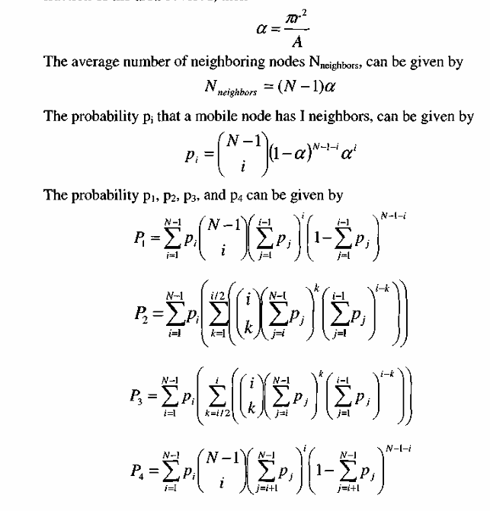
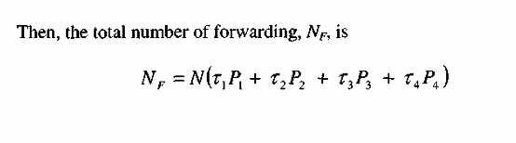
where Ti is the forwarding probability for the mobile node in group i (1 < i < 4).
Such a scheme does not provide 100% coverage of all MANET nodes [Zhang2005c], but a good coverage and excellent saving are achieved under mobility and about 20% higher goodput is obtained than the conventional AODV.

Slide 33
Lightweight and Efficient Network-Wide Broadcast
The Lightweight and Efficient Network-Wide Broadcast (LENWB) protocol [Sucec2000] also relies on two-hop neighbor knowledge obtained from hello packets.
However, instead of a node explicitly choosing other nodes to rebroadcast, the decision is implicit.
In LENWB, each node decides to rebroadcast based on knowledge of which of its other one and two-hop neighbors are expected to rebroadcast.
The information required for that decision is the knowledge of which neighbors have received a packet from the same source node, and which neighbors have a higher priority for rebroadcasting.
The priority is proportional to the number of neighbors of a given node. The higher a node's degree is, the higher is its priority. Since a node relies on its higher priority neighbors to rebroadcast, it can proactively determine if all of its lower priority neighbors will receive those rebroadcasts.

Slide 34
Multicasting
The problem of multicasting in MANETs is to broadcast a message to a subset of MANET MHs
We begin by understanding the hard task of multicasting to a group of mobile nodes, together with the various issues behind the design and implementation of a multicast protocol for MANETs.
we study the existing multicast protocols for MANETs and show how different they are as compared to broadcasting.

Slide 35
Issues in Providing Multicast in a MANET
Protocols designed for fixed networks, may fail to keep up with node movements and frequent topological changes as MHs become increasingly mobile, these protocols need to evolve to cope up with the new environment.
The host mobility increases the protocol overheads substantially.
The broadcast protocols cannot be used either as multicasting requires a selected set of nodes to receive the message while all multicast algorithm depend on the topology of the network and do not consider weather a node belongs to a group or not.
New protocols are being proposed and investigated which take issues such as locations of nodes belonging to a multicast group, and all associated topological changes.
The nodes of MANET run on batteries, routing protocols must limit the amount of control information that is passed between nodes.

Slide 36
The majority of applications are in the areas where rapid deployment and dynamic reconfiguration are necessary and the wireline network is not available.
These include military battlefields, emergency search and rescue sites, classrooms, and conventions where participants share information dynamically using their mobile devices.
These applications lend themselves well to multicast operation. In addition, within a wireless medium, it is even more crucial to reduce the transmission overhead and power consumption.
Transient loops may form during reconfiguration of distribution structure (e.g., tree) as a result of mobility. Therefore, reconfiguration scheme should be kept simple to maintain low channel overhead.

Slide 37
Multicast Routing Protocols
• Tree-Based Approaches;
• Meshed-Based Approaches;
• Stateless Multicast;
• Hybrid Approaches.

Slide 38
Tree-Based Approaches
Most of the schemes for providing multicast in wired network are either source-based or shared tree-based. Different researchers have tried to extend the idea of tree-based approach to provide multicast in a MANET environment.
Due to simplicity and innate properties of tree structures, many characteristics can be identified such as: a packet traverses each hop and node in a tree at most once, very simple routing decisions at each node, and the number of copies of a packet is minimized, tree structure built representing shortest paths amongst nodes, and a loop-free data distribution structure.
On the other hand, there are many issues that must be addressed in tree-based approaches. As mentioned earlier, trees provide a unique path between any two nodes. Having even one link failure could mean reconfiguration of the entire tree structure and could be a major drawback.
Multiple packets generated by different sources will require some consideration when utilizing multicast trees such that efficient routing can be established and maintained.
Thus, it is common to consider the use of either a shared tree or establish a separate tree per each source (i.e., separate source trees).
Each approach has to deal with own individual issues. For separate source trees, each router (or node in case of MANETs) involved in multiple router groups must maintain a list of pertinent information for each group in which it is involved. Such management per router is inefficient and not scalable.

Slide 39
Ad Hoc Multicast Routing Protocol Utilizing Increasing Id Numbers
Ad hoc Multicast Routing Protocol utilizing Increasing id-numberS (AMRIS) [Wul998] is an on-demand protocol, which constructs a shared multicast delivery tree (see Figure 3.4) to support multiple senders and receivers in a multicast session. AMRIS dynamically assigns an id number to each node in each multicast session.
Based on the id-number, a multicast delivery tree - rooted at a special node with Sid (Smallest-ID) - is created and the id-number increases as the tree expands from the Sid.
Generally, Sid is the source or the node that initiates a multicast session. The first step in AMRIS protocol operation is the selection of Sid. If there is only one sender for a group, the Sid is generally the source of the group. In case of multiple senders, a Sid is selected among the given set of senders.
Once a Sid is identified, it sends a NEW-SESSION message to its neighbors. The content of this message includes Sid's msm-id (multicast session member id) and the routing metrics.
Nodes receiving the NEW-SESSION message generate their own msm-ids, which is larger than the msm-id of the sender. In case a node receives multiple NEW-SESSION messages from different nodes, it keeps the message with the best routing metrics and calculates its msm-ids.
To join an ongoing session, a node checks the NEW-SESSION message, determines a parent with smallest msm-ids, and unicast a JOIN-REQ to its potential parent node. If parent node is already in the multicast delivery tree, it replies with a JOIN-ACK. Otherwise, the parent itself tries to join the multicast tree by sending a JOIN-REQ to its parent.

Slide 40
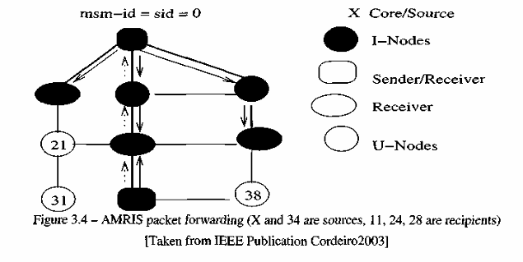

Slide 41
Multicast Ad Hoc On-Demand Distance Vector Protocol
The Multicast Ad hoc On-Demand Distance Vector (MAODV) routing protocol [Royerl999] follows directly from the unicast AODV, and discovers multicast routes on-demand using a broadcast route discovery mechanism employing the same Route Request (RREQ) and Route Reply (RREP) messages that issued in the unicast AODV protocol.
A MH originates a RREQ message when it wishes to join a multicast group, or when it has data to send to a multicast group but it does not have a route to that group.
Only a member of the desired multicast group may respond to a join RREQ. If the RREQ is not a join request, any node with a fresh enough route (based on group sequence number) to the multicast group may respond. If an intermediate node receives a join RREQ for a multicast group of which it is not a member, or if it receives a RREQ and it does not have a route to that group, it rebroadcasts the RREQ to its neighbors.
As the RREQ is broadcasted across the network, nodes set up pointers to establish the reverse route in their route tables. A node receiving a RREQ first, updates its route table to record the sequence number and the next hop information for the source node.
This reverse route entry may later be used to relay a response back to the source. For join RREQs, an additional entry is added to the multicast route table and is not activated unless the route is selected to be part of the multicast tree.
If a node receives a join RREQ for a multicast group, it may reply if it is a member for the multicast group's tree and its recorded sequence number for the multicast group is at least as great as that contained in the RREQ.

Slide 42
The responding node updates its route and multicast route tables by placing the requesting node's next hop information in the tables, and then unicasts a RREP back to the source.
As nodes along the path to the source receive the RREP, they add both a route table and a multicast route table entry for the node from which they received the RREP, thereby creating the forward path.
When a source node broadcasts a RREQ for a multicast group, it often receives more than one reply. The source node keeps the received route with the greatest sequence number and shortest hop count to the nearest member of the multicast tree for a specified period of time, and disregards other routes.
At the end of this period, it enables the selected next hop in its multicast route table, and unicasts an activation message (MACT) to this selected next hop.
The next hop then enables the entry for the source node in its multicast routing table. If this node is a member of the multicast tree, it does not propagate the message any further.
However, if this node is not a member of the multicast tree, it would have received one or more RREPs from its neighbors. It keeps the best next hop for its route to the multicast group, unicasts MACT to that next hop, and enables the corresponding entry in its multicast route table.
This process continues until the node that originated the chosen RREP (member of tree) is reached. The activation message ensures that the multicast tree does not have multiple paths to any node in the tree. Note that nodes only forward data packets along activated routes.

Slide 43
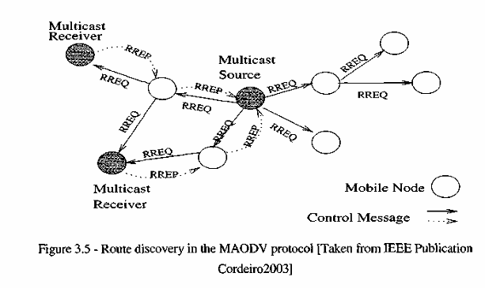

Slide 44
Lightweight Adaptive Multicast (LAM)
The Lightweight Adaptive Multicast (LAM) protocol [Jil998] draws on the Core-Based Tree (CBT) protocol [Ballardiel993] and the TORA unicast routing algorithm in order to provide multicast services over MANETs.
As CBT is a traditional method originally designed for wired networks, with each multicast group initialized and maintained by a multicast server, or core.
Hence, any node which wants to communicate with a specific multicast group can query the directory server.
LAM is based on the assumption that a tightly coupled unicast-multicast routing protocol is more suitable for MANETs than a multicast protocol.
Although this coupling makes it less portable, it may be more efficient due to elimination of duplicated control functionality between different protocol layers.
LAM built on TORA unicast routing infrastructure, can provide multiple routes, and all network nodes are globally ordered.

Slide 45
Similar to CBT, LAM builds a group-shared multicast routing tree for each multicast group centered at the CORE. The goal is to build a multicast tree which is source-initiated and group-shared.
Nodes in LAM maintain two variable, POTENTIAL-PARENT and PARENT, and two lists POTENTIAL-CHILD-LIST and CHILD-LIST.
The PARENT variable is used to remember the parent node in the multicast tree. The CHILD-LIST stores identities of one-hop children in the multicasting tree.
These potential data objects are used when the node is in a "join" or "rejoin" waiting state. Since LAM is based on CBT approach to build the multicast delivery tree, with one CORE for a group, LAM is not very robust, especially in a MANET environment.
To address the problem posed by having a single centralized core, Inter-core LAM (IC-LAM) is proposed [Jil998]. IC-LAM is a tunnel-based protocol connecting multiple cores. By allowing multiple cores, IC-LAM avoids total group failure due to a single core failure.

Slide 46
Location Guided Tree Construction Algorithm for Small Group Multicast
The Location Guided Tree (LGT) [Chen2002] is a small group multicast schemes based on packet encapsulation. It builds an overlay multicast packet distribution tree on top of the underlying unicast routing protocol.
Multicast data is encapsulated in a unicast packet and transmitted only among the group nodes. It is based on the construction of two types of tree, location-guided k-array (LGK) tree and a location guided Steiner (LGS) tree.
The geometric location information of the destination nodes is utilized to construct the packet distribution tree without knowing the global topology of the network (Figure 3.6).
It is assumed that the longer the geometric distance is, longer will be the network-level hops to reach the destination. Therefore, algorithms attempt to construct a tree with geometrically shorter tree edges.
The protocol also supports an optimization mechanism through route caching, wherein a node can cache the computed route and re-use the route next time when a new packet comes in with the same set of destinations.
In LGK tree approach, the sender first selects nearest k destinations as children nodes. The sender then groups the rest of the nodes to its k children as per the closeness to geometric proximity.

Slide 47
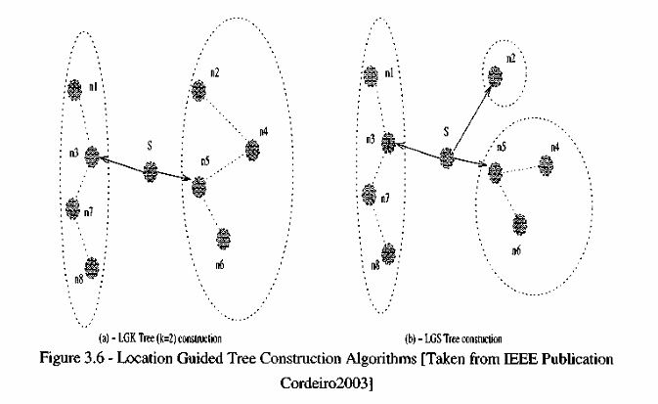
Once the group nodes are mapped to its corresponding child nodes, the sender forwards a copy of the encapsulated packet to each of the k children with its corresponding subtree (sub destination list of group members) as destinations. The process stops when an in-coming packet has an empty destination list. In the LGS scheme, based on the geometric distance as a measurement of closeness, a Steiner tree is constructed, which uses the multicast group members as tree nodes. The protocol uses a hybrid mechanism for location/membership update, which includes in-band update and periodic update.

Slide 48
Multicast Zone Routing
The Multicast Zone Routing (MZR) protocol [Devarapalli2001] is based on, but is not dependent on any specific routing mechanism.
It takes into consideration the hierarchical structure used by the ZRP unicast routing protocol. As we have seen before, a ZRP network is partitioned into zones.
Each node computes its own zone, which is determined to be the set of nodes that lie within a certain zone radius of the node.
ZRP is described as a hybrid approach between the proactive and reactive routing protocols, where routing is proactive inside the zones (i.e., a unicast route is proactively maintained between every pair of nodes in a zone) and reactive between the zones (i.e., a route between two nodes in different zones is created when needed).
To create a zone, a MZR node A broadcasts an ADVERTISEMENT message with a time-to-live (TTL) equal to a pre-configured ZONE RADIUS, or the radius of the zone.

Slide 49
Node B within the zone radius decrements the TTL and forwards the message if appropriate. Node B makes an entry in its routing table for node A, with the last hop of the ADVERTISEMENT message as the next hop towards the destination, i.e., the source of the ADVERTISEMENT message.
The distance is set to the hop count of the packet. Nodes that are ZONE-RADIUS hops away from node A become border nodes, and serve as a gateway between node A's zone and the rest of the network for zone routing and multicast zone routing.
In the spirit of zone routing, MZR begins its search for a multicast tree within the zone before extending the search outward. MZR is a source-specific algorithm, meaning that a multicast tree is created for each source-group pair. When a source wants to start sending multicast traffic it initiates the construction of a multicast tree.
The source node sends a TREE-CREATE packet to each node in its zone. Nodes that receive this message and want to receive multicast data respond with a TREE-CREATE-ACK packet. A TREE-CREATE-ACK packet is sent back to the source of the multicast session and, as the packet travels up the tree, intermediate nodes mark in their routing tables the last hop of the TREE-CREATE-ACK as a downstream node. In this way, a reverse multicast path is created. Tree creation continues in the new zone in the same way as described above and an example is shown in Figure 3.7 taken from [Devarapalli2001].

Slide 50
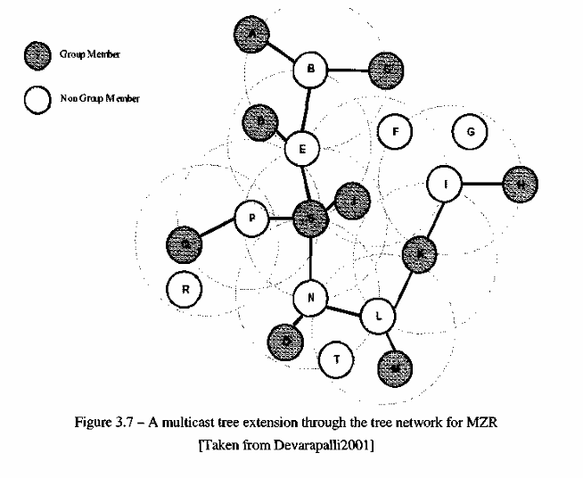

Slide 51
Multicast Optimized Link State Routing
As in MZR, the Multicast Optimized Link State Routing (MOLSR) protocol [Jacquet2001] (an extension of the OLSR unicast routing protocol) creates a source specific multicast tree.
Unlike MZR, MOLSR is dependent on OLSR as an underlying unicast routing algorithm. Multicast-capable routers in an OLSR network periodically advertise their ability to route and build multicast routes with a MC_CLAEVI message.
This message carries no information and is only used to declare the router's capabilities to the network. MC_CLAEVI messages are sent to every node in the network every MC_CLAEVI_PERIOD seconds.
Because the information in a MC_CLAIM message does not change over time, a relatively long MC_CLAIM_PERIOD should be used.
Using this and the information provided by the OLSR's TC messages, MOLSR nodes can calculate shortest path routes to every potential multicast source.
This is done in the same manner seen in OLSR, except that now the routes consist entirely of multicast-capable OLSR routers. Multicast routes are built in a backward manner similar to the method used in MZR.
A source that wants to send multicast traffic advertises its intentions by broadcasting a SOURCE_CLAEVI message to every node in the network.
Before responding to the SOURCE_CLAIM, a multicast receiver first checks its multicast routing table. If an entry does not already exist, the node creates one and sets the timer to the SOURCE_HOLD_TEVIE and the list of child nodes to null.
The node then sets the parent node to the next hop towards the multicast source, as determined from its multicast routing table, and sends a CONFIRM_PARENT to the parent node.
If an entry does exist, the node simply updates the timer, and does not send a CONFIRM_PARENT message to its parent.

Slide 52
In either case, if the node is an MPR node for the last hop, it forwards the SOURCE_CLAIM. When a node receives a CONFIRM_PARENT message it checks its multicast routing table for an entry.
If the entry does not exist, it creates one and sets the sons and parents to null.
If the last hop of the CONFIRM_PARENT packet does not exist in the sons list, it adds and updates the son timer to SON_HOLD_TEVIE. If the son does exist, it simply updates the SON_HOLD_TIME.
The node then sets the parent address to the next hop in the multicast routing table to reach the source, as determined by the multicast routing table.
A multicast source periodically sends a SOURCE_CLAIM message to every node in the network for two reasons. First, it informs multicast receivers that the source is still sending data and that all of the nodes in the multicast tree should update their multicast timers.
Second, it allows unattached hosts to join the multicast group. If a node detects that the next hop entry towards the multicast source has changed, a node must inform the new entry that it is now a multicast parent.
To do this, the node must send a CONFIRM_PARENT message to the node.
If the old parent is reachable, the node may send a LEAVE message to the old parent to disable the route. A node periodically sends out CONFIRM_PARENT messages to inform its parents that it still wishes to receive multicast traffic.
A MOLSR node that wants to leave a multicast group and that has no sons sends a LEAVE message to its parent. The parent removes this node from the son list and, if the list becomes empty, it sends a LEAVE message to its parent.
This continues until a node that wants to receive data or a node with at least two sons, is reached.
As mentioned above, a node may send a LEAVE message if a change in network topology causes a change in the multicast tree.

Slide 53
Other Protocols
The Associativity-Based Ad Hoc Multicast (ABAM) [Tob.2000] is an on-demand source-initiated multicast routing protocol for ad hoc wireless networks.
Here, a multicast tree is built for each multicast group based on association stability. The link status of each node is monitored by its neighbors.
ABAM deals with the network mobility on different levels according to varying mobility effects: branch repair when the receiver moves, sub-tree repair when a branching node moves, and full tree level repair when the source node moves. Tree reconfiguration is required only when a link is broken, and a localized repair strategy comes into picture.
In contrast to local control in ABAM and MZR, the On-demand Location-Aware Multicast (OLAM) protocol [Basagni2000] proposed a global method. OLAM is based on the expectation that each node is equipped with a positioning device such as GPS.

Slide 54
With this assumption, each node can process and take a snapshot of the network topology and make up a multicast tree (minimum spanning tree).
This protocol does not use any distributed data structures or ad hoc routing protocol as foundation. Although it is shown in [Basagni2000] that OLAM's overhead is low and that it works well for varying mobility and group sizes, when the multicast tree is very large the GPS measurements may become a huge burden for the network nodes.
Because on-demand operation is driven by the presence of data packets instead of periodic or continuous control flooding, on-demand protocols are expected to lower control overhead and react quickly to routing changes. In view of this fact, the Adaptive Demand-Driven Multicast Routing (ADMR) [Jetcheva2001a] proposes a protocol that attempts to reduce non-on-demand components.
ADMR uses tree flood to enable packets to be forwarded following variant branches in the multicast tree. A multicast packet in ADMR floods within the multicast distribution tree only towards the group's receivers. The use of tree flood also increases the robustness of the tree structure. It also tends to scale well with group size and mobility.

Slide 55
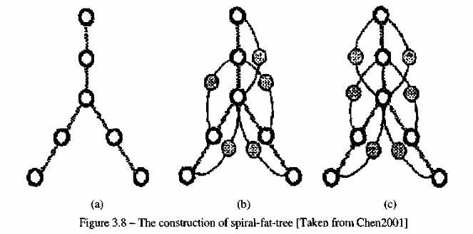
Mesh-Based Approaches
In contrast to the tree-based approach, mesh-based multicast protocols may have multiple paths between any source and receiver pairs.
Existing studies show that tree-based protocols are not necessarily the best suited for multicast in a MANET environment if the network topology changes frequently.
In such an environment, mesh-based protocols seem to outperform tree-based proposals due to availability of alternative paths, which allow multicast datagrams to be delivered to the receivers even if links fail.

Slide 56
The disadvantage of a mesh is the increase in data-forwarding overhead. The redundant forwarding consumes more bandwidth in the bandwidth constrained ad hoc networks.
Moreover, the probability of collisions is higher when a larger number of packets are generated. Therefore, one common problem mesh-based protocols have to consider is how to minimize the data-forwarding overhead caused by flooding.
As we shall see, different protocols attack this issue in different ways through the use of forwarding groups, cores, and so on. This section gives an overview of the mesh-based approaches that support multicast in MANETs.

Slide 57
On-Demand Multicast Routing Protocol
On-demand Multicast Routing Protocol (ODMRP) [Gerla2000] is a mesh-based protocol, which employs a forwarding group concept (only a subset of nodes forwards the multicast packets).
A soft state approach is taken in ODMRP to maintain multicast group members. No explicit control message is required to leave the group.
The group membership and multicast routes are established and updated by the source on demand. When a multicast source has packets to send, but no route to the multicast group, it broadcasts a Join-Query control packet to the entire network.
This Join-Query packet is periodically broadcasted to refresh the membership information and updates routes as depicted in Figure 3.9. When an intermediate node receives a Join-Query packet, it stores the source ID and the sequence number in its message cache to detect any potential duplicates.
The routing table is updated with an appropriate node ID (i.e., backward learning) from which the message was received. If the message is not a duplicate and the TTL is greater than zero, it is rebroadcasted.
When a Join-Query packet reaches a multicast receiver, it creates and broadcasts a Join-Reply to its neighbors. When a node receives a Join Reply, it checks if the next hop node ID of one of the entries matches its own ID.
If it does, the node realizes that it is on the path to the source and thus is a part of the forwarding group and sets the FG_FLAG (Forwarding Group Flag). It then broadcasts its own Join-Reply built upon matched entries.
The next hop node ID field contains the information extracted from its routing table. In this way, each forward group member propagates the Join-Reply until it reaches the multicast source via the selected (shortest) path.
This whole process constructs (or updates) the routes from sources to receivers and builds a mesh of nodes.

Slide 58
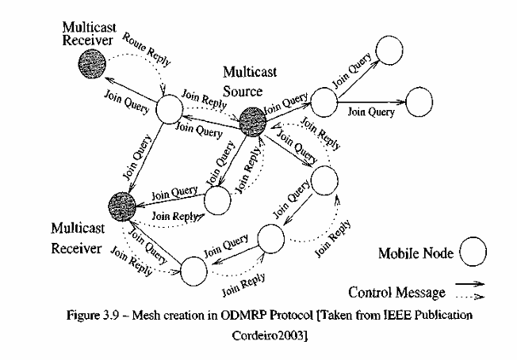

Slide 59
Core-Assisted Mesh Protocol
The Core-Assisted Mesh Protocol (CAMP) [Garcia-Luna-Aceves 1999b] supports multicasting by creating a shared mesh for each multicast group.
Meshes thus created, helps in maintaining the connectivity to the multicast users, even in case of node mobility. It borrows concepts from CBT, but the core nodes are used for control traffic needed to join multicast groups.
The basic operation of the CAMP includes building and maintaining the multicast mesh for a multicast group. It assumes a mapping service, which provides routers with the addresses of groups identified by their names.
Each router maintains a routing table (RT) built with the unicast routing protocol and is modified by CAMP when a multicast group needs to be inserted or removed.
A router may update its MRT based on topological changes or messages received from its neighbors. CAMP classifies the nodes in the network in three modes: simplex, duplex and non-member.

Slide 60
A router joins a group in a simplex mode if it intends only to send traffic received from specific nodes or neighbors to the rest of the group, and does not intend to forward packets from the group.
A duplex member forwards any multicast packets for the group, whereas a non-member node needs not to be in the multicast delivery mesh. CAMP uses a receiver-initiated method for routers to join a multicast group.
If a router wishing to join a group has multiple neighbors that are duplex members of the multicast group, then it simply changes its MRT and directly announces to its neighbors that it's a new member for the multicast group using multicast routing update.
If it has no neighbors that are members of the multicast group, it either propagates a join request to one of the multicast group "cores" or attempts to reach a member through expanding ring search [Perkins2003].
Any router that is a regular member of the multicast group and has received the join request, is free to transmit a join acknowledgement (ACK) to the sending router.

Slide 61
Forwarding Group Multicast Protocol
Forwarding Group Multicast Protocol (FGMP) [Chiangl998] can be viewed as flooding with "limited scope", wherein the flooding is contained within a selected forwarding group (FG) nodes.
FGMP makes innovative use of flags and an associated timer to forward multicast packets. When the forwarding flag is set, each node in FG forwards data packets belonging to a group G with flags on until the timer expires.
This soft state approach of using timer works well in dynamically changing environments. FGMP uses two approaches to elect and maintain FG of forwarding nodes: FGMP-RA (Receiver Advertising) and FGMP-SA (Sender Advertising).
In FGMP-RA, multicast receivers periodically announce their group membership by flooding. Senders maintain a table with all receivers of the group. In FGMP-SA, a sender periodically announces its presence in network by flooding.
The nodes, which relay this message, store the next-hop to the sender. Multicast receivers join the group by sending replies to the sender.
FGMP can be seen as a twin method to ODMRP, where their main difference relies on the way group meshes are established. Both FGMP and ODMRP do have, however, scalability problems due to flooding of control packets.

Slide 62
Other Protocols
In addition to the forwarding groups and cores used in the previously discussed mesh-based multicast protocols, a local routing scheme is proposed in the Neighbor Supporting ad hoc Multicast routing Protocol (NSMP) [Lee2000a] to lower the network load.
In NSMP, there are two types of route discovery: flooding route discovery and local route discovery. In flooding route discovery, control packets flood the entire network in the initial route establishment or in repair of network partitions, while in local route discovery only a small number of nodes related to the multicast group are involved for routine path maintenance.
In selecting a route, NSMP prefers a path with more existing forwarding nodes, which is supposed to reduce the total number of forwarding nodes and increase the route efficiency.
The neighboring nodes of the multicast group are important for mesh maintenance. The neighbors are also used to limit the control messages to a small part of the nodes and minimize the frequency to flood the complete network.
Result in [Lee2000a] reports that NSMP has decreased transmissions and reduced control overhead as compared to the ODMRP.

Slide 63
Stateless Approaches
Tree-based and mesh-based approaches have an overhead of creating and maintaining the delivery tree/mesh with time.
In a MANET environment, frequent movement of MHs considerably increases the overhead in maintaining the delivery tree/mesh.
To minimize the effect of such a problem, stateless multicast is proposed wherein a source explicitly mentions the list of destinations in the packet header.
Stateless multicast approaches focus on small group multicast and assumes the underlying routing protocol to take care of forwarding the packet to the respective destinations based on the addresses contained in the header.
In this section we present the main stateless multicast routing protocols proposed for use in MANETs.

Slide 64
Differential Destination Multicast
Differential Destination Multicast (DDM) protocol [Ji2001] is meant for small-multicast groups operating in dynamic networks of any size.
Unlike other MANET routing protocols, DDM lets source to control multicast group membership. The source encodes multicast receiver addresses in multicast data packets using a special DDM Data Header.
This variable length destination list is placed in the packet headers, resulting in packets being self-routed towards the destinations using the underlying unicast routing protocol.
It eliminates maintaining per-session multicast forwarding states at intermediate nodes and thus is easily scalable with respect to the number of sessions.
DDM supports two kinds of operating modes: "stateless" and "soft state". In stateless mode, the nodes along the data forwarding paths need not maintain multicast forwarding states.
An intermediate node receiving a DDM packet only needs to look at the header to decide how to forward the packet. In the "soft-state" mode, based on in-band routing information, each node along the forwarding path remembers the destinations to which the packet has been forwarded last time and its next hop information.
By caching this routing information at each node, the protocol does not need to list the entire destination in future data packets.
In case changes occur in the underlying unicast routing, an upstream node only needs to inform its downstream nodes about the differences in the destination forwarding since the last packet; hence the name "Differential Destination Multicast".

Slide 65
DSR Simple Multicast and Broadcast Protocol
The DSR Simple Multicast and Broadcast protocol (DSR-MB) [Jetcheva2001b] is designed to provide multicast and broadcast functionality in ad hoc networks.
It utilizes the Route Discovery mechanism defined by the DSR unicast protocol to flood the data packets in the network. Although this is derived from DSR, it can be implemented as a stand-alone protocol.
In fact, it does not rely on unicast routing to operate. If DSR has already been implemented on the network, minor modifications are required to enable this protocol.
This multicast and broadcast protocol utilizes controlled flooding to distribute data in the network and does not require establishment of a state in the network for data delivery.
It is not intended as a general purpose multicast protocol. Its applicability is mainly in environments characterized by very high mobility or by a relatively small number of nodes.
In the former case, protocols relying on the establishment of multicast state perform inadequately because they are unable to track the rapid changes in topology.
In the latter case, the overhead of keeping multicast state exceeds the overhead of flooding.

Slide 66
Hybrid Approaches
The protocols to provide multicast in ad hoc networks discussed so far, either address efficiency or robustness but not both simultaneously.
The tree-based approaches provide high data forwarding efficiency at the expense of low robustness, whereas mesh-based approaches lead to better robustness (link failure may not trigger a reconfiguration) at the expense of higher forwarding overhead and increased network load.
Thus, there is a possibility that a hybrid multicasting solution may achieve better performance by combining the advantages of both tree and meshed-based approaches.
In this section, we explore the different hybrid approaches to enable ad hoc multicasting.

Slide 67
Ad Hoc Multicast Routing Protocol
The Ad hoc Multicast Routing Protocol (AMRoute) [Bommaiahl998] creates a bi-directional, shared tree by using only group senders and receivers as tree nodes for data distribution.
The protocol has two main components: mesh creation and tree setup (see Figure 3.10). The mesh creation identifies and designates certain nodes as logical cores and these are responsible for initiating the signaling operation and maintaining the multicast tree to the rest of the group members.
A non core node only responds to messages from the core nodes and serves as a passive agent. The selection of logical core in AMRoute is dynamic and can migrate to any other member node, depending on the network dynamics and the group membership.
AMRoute does not address network dynamics and assumes the underlying unicast protocol to take care of it. To create a mesh, each member begins by identifying itself as a core and broadcasts JOIN_REQ packets with increasing TTL to discover other members.

Slide 68
When a core receives JOIN_REQ from a core in a different mesh for the same group, it replies with a JOIN_ACK. A new bi-directional tunnel is created between the two cores and one of them is selected as core after the mesh merger. Once the mesh has been established, the core initiates the tree creation process.
The core sends out periodic TREE_CREATE messages along all links incident on its mesh. Using unicast tunnels, the TREE_CREATE messages are sent only to the group members.
Group members receiving non-duplicate TREE_CREATE message forwards it to all mesh links except the incoming one, and marks the incoming and outgoing links as a tree links.
If a link is not going to be used as part of the tree, the TREE_CREATE is discarded and TREE_CREATE__NAK is sent back to incoming links.
A member node, which wants to leave a group, can do so by sending a JOESLNAK message to its neighboring nodes.

Slide 69
Multicast Core-Extraction Distributed Ad Hoc Routing
The Multicast Core-Extraction Distributed Ad hoc Routing (MCEDAR) [Sinhal999] is a multicast extension to the CEDAR architecture.
The main idea of MCEDAR is to provide the efficiency of the tree-based forwarding protocols and robustness of mesh-based protocols by combining these two approaches.
It is worth pointing out that a source-based forwarding tree is created on a mesh. As such, this ensures that the infrastructure is robust and data forwarding occurs at minimum height trees.
MCEDAR decouples the control infrastructure from the actual data forwarding in order to reduce the control overhead. The underlying unicast protocol, CEDAR, provides the core broadcasting for multicasting.
The core is used for routing management and link state inspection. Also, the cores make up the mesh infrastructure which is referred to as an mgraph, and use joinlDs to perform the join operation.
As MCEDAR uses a mesh as the underlying infrastructure, it can tolerate a few link breakages without reconfiguration.
The efficiency is achieved by using a forwarding mechanism on the mesh that creates an implicit route-based forwarding tree. As mentioned earlier, this ensures that the packets need to travel only the minimum distance in the tree.

Slide 70
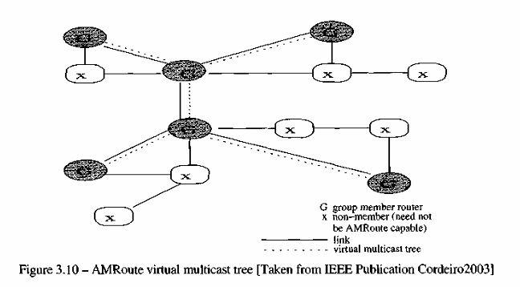

Slide 71
Mobility-Based Hybrid Multicast Routing
The Mobility-based Hybrid Multicast Routing (MHMR) protocol [An2001] is built on top of the mobility-based clustering infrastructure. In order to deal with the issues of scalability and stability, the structure is hierarchical in nature.
The mobility and positioning information is provided via a GPS for each node. For a group of nodes, a cluster-head is chosen to manage and monitor the nodes in a cluster.
A mesh structure is built based on all the current clusters. Thus, MHMR achieves high stability.
This is followed by a tree structure built based on the mesh to ensure that the multicasting group achieves maximal efficiency.
MHMR also provides a combination of proactive and reactive concepts which enable low route acquisition delay of proactive schemes while achieving low overhead of reactive methods.
It is interesting to note that cores are employed in both AMRoute and MCEDAR, as well as in many tree and mesh multicast algorithms.
The use of cores has been shown to lower the control overhead. The use of cluster-heads has been proposed in MHMR. This has been shown to be a reasonable approach since dividing the nodes in an ad hoc network into clusters seems to be a promising method in taking care of highly dynamic nodes.
Hybrid methods can reveal themselves to be attractive as they can provide protocols that can address further robustness and efficiency.
Though hybrid protocols have not been as deeply investigated as tree and mesh protocols, they are under development and recent results indicate its promising future.

Slide 72
Comparison
The basic idea behind defining multicast routing protocol for MANET is to form path to the group members, with minimal redundancy and various algorithms described earlier, do attempt to achieve this goal using different mechanisms.
The host mobility also influences the routes being selected and possibility of loop formation or the paths becoming non-optimal are important.
It is also critical to know if the paths created is on demand, or optimal paths are determined once and updated periodically when needed.
Another important consideration is if the control packets are flooded throughout the network or it is limited to some nodes in the multicast delivery tree.
Keeping this in mind, Table 3.1 compares different proposals to provide multicasting over MANETs using various metrics. A performance study of various multicast routing protocols can be found in [Lee2000b].

Slide 73
Geocasting
We now turn our attention to the problem of geocasting over MANETs. As we have mentioned earlier, geocasting is a variant of the conventional multicasting problem and distinguishes itself by specifying hosts as group members within a specified geographical region.
In geocasting, the nodes eligible to receive packets are implicitly specified by a physical region and membership changes as mobile nodes move in or out of the geocast region.

Slide 74
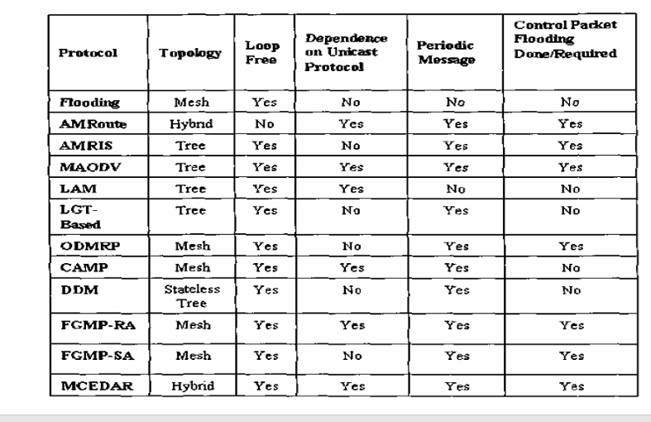

Slide 75
The concept of geocast was first introduced in [Navasl997] as an Internet addition, not MANET additions.
The GPS application in geographic messaging is described in [Navasl997], where it is discussed how to send packets to users who are located on a wired network within a particular polygon or circle defined by latitude and longitude.
In future, it may be possible that GPS is deployed in almost every user terminal. With GPS, each node has its location readily available.
Here, we assume that whenever a node in the geocast region receives a geocast packet, it floods the geocast packet to all its neighbors. In other words, flooding of geocast packets takes place within the geocast region.
All geocast protocols presented here follow this assumption. One effect of this assumption is that a geocast protocol works if at least one node in the geocast region receives the geocast packet.
Lastly, we assume that the protocols presented here use a jitter technique in order to avoid two packets colliding with each other by a broadcast.

Slide 76
In other words, nodes offset transmissions by a random jitter to avoid their neighbors sending packets at the same time.
This issue has been discussed in the previous chapter. In this section, we classify existing geocast protocols into two categories: data-transmission oriented protocols and routing creation oriented protocols.
Since all the nodes in the geocast region share information among each other by flooding, the difference between these two categories is how they transmit information from a source to one or more nodes in the geocast region. Data-transmission oriented protocols use flooding or a variant of flooding to forward geocast packets from the source to the geocast region.
Routing-creation oriented protocols create routes from the source to the geocast region via control packets. Both of these techniques eventually reach one or more nodes in the geocast region.

Slide 77
Geocast Routing Protocols
Data-Transmission Oriented
Data-transmission oriented geocast protocols use flooding or a variant of flooding to forward data from the source to the geocast region - and are described

Slide 78
Location-Based Multicast
The Location-Based Multicast (LBM) protocol [Kol999] extends the LAR unicast routing algorithm for geocasting.
As we have seen, LAR is an approach to utilize location information to improve the performance (i.e., higher data packet delivery ratio and lower overhead) of a unicast routing protocol in a MANET.
Similarly, the goal of LBM is to decrease delivery overhead of geocast packets by reducing the forwarding space for geocast packets, while maintaining accuracy of data delivery.
The LBM algorithm is based upon a flooding approach. LBM is essentially identical to flooding data packets, with the modification that a node determines whether to forward a geocast packet further via one of two schemes.

Slide 79
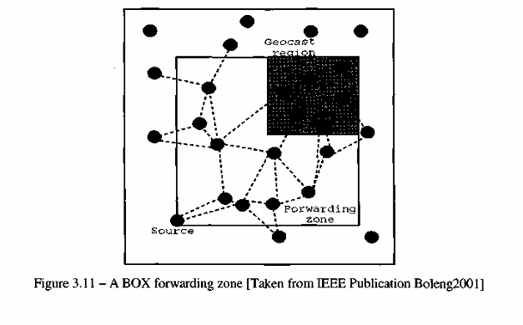
• LBM Scheme 1: When a node receives a geocast packet, it forwards the packet to its neighbors if it is within & forwarding zone; otherwise, it discards the packet. Thus, how to define the forwarding zone becomes the key point of this scheme. Figure 3.11 shows one example of a forwarding zone [Boleng2001]. In Figure 3.11, the size of the forwarding zone is dependent on (i) the size of the geocast region and (ii) the location of the sender. In a BOX Forwarding Zone, the smallest rectangle that covers both the source node and the geocast region defines the forwarding zone. All the nodes in the forwarding zone forward data packets to their neighbors. Other kinds of forwarding zones are possible, such as the CONE Forwarding Zone [Boleng2001]. A parameter

Slide 80
• LBM Scheme 2: Unlike scheme 1, in which a geocast packet is forwarded based on the forwarding zone, scheme 2 does not have a forwarding zone explicitly. Instead, whether a geocast packet should be forwarded is based on the position of the sender node at the transmission of the packet and the position of the geocast region.
That is, for some parameter 8, node B forwards a geocast packet from node A (originated at node S), if node B is "at least. S closer" to the center of the geocast region (Xc, Yc) than node A.
In other words, DISTA > DISTB+ S. We define (Xc, Yc) as the location of the geometrical center of the geocast region, and for any node Z, DISTz denotes the distance of node Z from (Xc, Yc). In Figure 3.12 [Kol999], node B will forward a geocast packet transmitted by node A since DISTA > DISTB and. d= 0. Node K will, however, discard a geocast packet transmitted by node B, since node K is not closer to (Xc, Yc) than node B.
In brief, this protocol ensures that every packet transmission sends the packet closer to the destination. As for the performance, the accuracy (i.e., ratio of the number of geocast group members that actually receive the geocast packets to the number of group members that were supposed to receive the packets) of both LBM schemes is comparable with that of flooding geocast packets throughout the network.
However, the number of geocast packets transmitted (a measure of the overhead) is consistently lower for LBM than simple flooding.

Slide 81
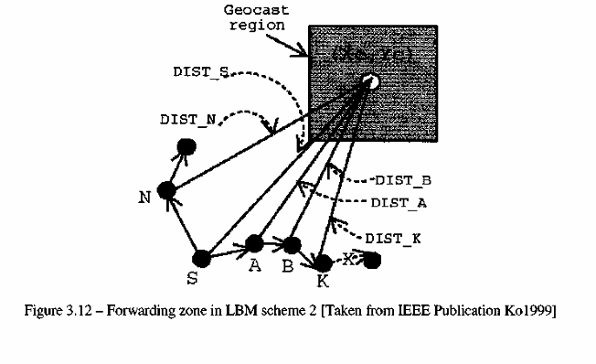

Slide 82
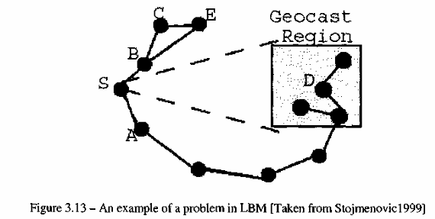
Voronoi Diagram Based Geocasting
The goal of the Voronoi Diagram based Geocasting (VDG) protocol [Stojmenovicl999] is to enhance the success rate and decrease the hop count and flooding rate of LBM.
It is observed that the forwarding zone defined in LMB may be a partitioned network between the source node and the geocast region, although there exists a path between the source and the destination.
An example of this problem is illustrated in Figure 3.13.

Slide 83
In VDG, the definition of the forwarding zone of LBM has been modified. The neighbors of node A that are located within the forwarding zone in VDG are exactly those neighbors that are closest in the direction of the destination.
This definition of a forwarding zone not only resolves the problem of having no nodes inside the forwarding zone, but also precisely determines the expansion of the forwarding zone.
This forwarding zone can be implemented with a Voronoi diagram for a set of nodes in a given node's neighborhood of a MANET.
A Voronoi diagram of n distinct points (i.e., n neighbors) in a plane is a partition of the plane into n Voronoi regions, which, when associated with node A, consists of all the points in the plane that are the closest to A.
In other words, the Voronoi diagram model is a model where every point is assigned to a Voronoi region.
The subdivision induced by this model is called the Voronoi diagram of the set of nodes [Berg]. For example, in Figure 3.14 [Stojmenovicl999] five neighbors of source node S (A, B, C, E and F) In VDG, the definition of the forwarding zone of LBM has been modified.

Slide 84
The neighbors of node A that are located within the forwarding zone in VDG are exactly those neighbors that are closest in the direction of the destination.
This definition of a forwarding zone not only resolves the problem of having no nodes inside the forwarding zone, but also precisely determines the expansion of the forwarding zone.
This forwarding zone can be implemented with a Voronoi diagram for a set of nodes in a given node's neighborhood of a MANET. A Voronoi diagram of n distinct points (i.e., n neighbors) in a plane is a partition of the plane into n Voronoi regions, which, when associated with node A, consists of all the points in the plane that are the closest to A.
In other words, the Voronoi diagram model is a model where every point is assigned to a Voronoi region. The subdivision induced by this model is called the Voronoi diagram of the set of nodes [Berg]. For example, in Figure 3.14 [Stojmenovicl999] five neighbors of source node S (A, B, C, E and F)

Slide 85
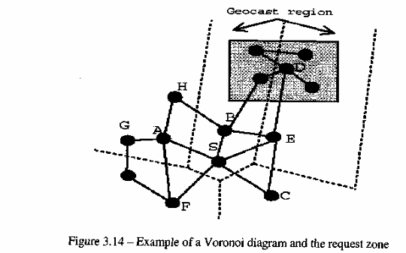

Slide 86
GeoGRID
Based on the unicast protocol GRID [Liao2001], the GeoGRID protocol [Liao2000] uses location information, which defines the forwarding zone and elects a special host (i.e, gateway) in each grid area responsible for forwarding the geocast packets.
It is argued in [Liao2000] that the forwarding zone in LBM incurs unnecessary packet transmissions, and a tree-based solution is prohibitive in terms of control overhead.
GeoGRID partitions the geographic area of the MANET into two-dimensional (2D) logical grids. Each grid is a square of size d X d (there are trade-offs in choosing a good value of d, as discussed in [Liao2000].) In GeoGRID, a gateway node is elected within each grid.
The forwarding zone is defined by the location of the source and the geocast region. The main difference between GeoGRID, LBM and VDG is the following: in GeoGRID, instead of every node in a forwarding zone transmitting data, only gateway nodes take this responsibility.

Slide 87
There are two schemes on how to send geocast packets in GeoGRID: Flooding-Based GeoGRID and Ticket-Based GeoGRID. In Flooding-Based GeoGRID, only gateways in every grid within the forwarding zone rebroadcast the received geocast packets. Thus, gateway election becomes the key point of this protocol.
In Ticket-Based GeoGRID, the geocast packets are still forwarded by gateway nodes, but not all the gateways in the forwarding zone forward every geocast packet. A total of m + n tickets are created by the source if the geocast region is a rectangle of m X n grids. The source evenly distributes the m + n tickets to the neighboring gateway nodes in the forwarding zone that are closer to the geocast region than the source.
A gateway node that receives X tickets follows the same procedure as the one defined for the source. Consider the example in Figure 3.15 where node S begins with five (2+3) tickets. Node S may distribute two tickets to its neighboring nodes A and B, and one ticket to its neighbor node C, which are closer to the geocast region than node S

Slide 88
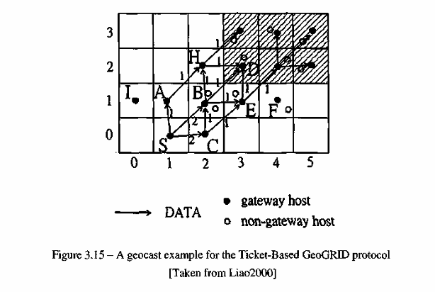

Slide 89
Route Creation Oriented
As discussed in the previous chapter, flooding of packets may cause a broadcast storming effect, generating serious redundancy, contention and collision problems.
In this section we introduce routing-creation oriented protocols, which create routes to transmit data from the source to the geocast region.
One advantage of this kind of protocol is the reduced overhead in the transmission of data packets, as compared to data-transmission oriented protocols.
One disadvantage is that it requires higher latency and control overhead to establish the routes.

Slide 90
GeoTORA
The goal of the GeoTORA protocol [Ko2000] is to reduce the overhead of transmitting geocast packets via flooding techniques, while maintaining high accuracy. .
The unicast routing protocol TORA is used by GeoTORA to transmit geocast packets to a geocast region. As TORA is a distributed routing protocol based on a "link reversal" algorithm, it provides multiple routes to a destination.
Despite dynamic link failures, TORA attempts to maintain a destination-oriented directed acyclic graph such that each node can reach the destination.
In GeoTORA, a source node essentially performs an anycast to any geocast group member (i.e, any node in the geocast region) via TORA.
When a node in the geocast region receives the geocast packet, it floods the packet such that the flooding is limited to the geocast region.
The accuracy of GeoTORA is high, but not as high as pure flooding or LBM.
One reason is only one node in the geocast region receives the geocast packet and if that node is partitioned from other nodes in the geocast region, the accuracy reduces.

Slide 91
Mesh-Based Geocast Routing Protocol
The Mesh-based Geocast Routing (MGR) protocol [Boleng2001] uses a mesh for geocasting in an ad hoc environment in order to provide redundant paths between the source and the group members.
Since the group members in a geocast region are in close proximity to each other, it is less costly to provide redundant paths from a source to a geocast region than to provide the redundant paths from a source to a multicast group of nodes that may not be in close proximity of each other.
Instead of flooding geocast packets, the MGR Protocol tries to create redundant routes via control packets. First, the protocol floods JOIN-DEMAND packets in a forwarding zone.
A JOIN-DEMAND packet is forwarded in the network until it reaches a node in the geocast region. This node unicasts a JOIN-TABLE packet back to the source by following the reverse route of the JOIN-DEMAND packet.
Thus, the nodes on the edge of the geocast region become a part of the mesh.
Once the first JOIN TABLE packet is received by the source, data packets can be sent to the nodes in the geocast region. Figure 3.16 shows an example of geocast communication via a mesh.

Slide 92
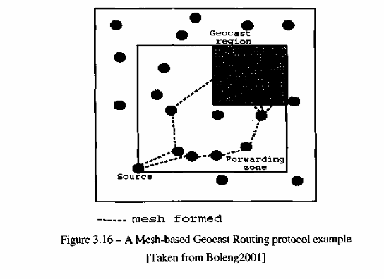

Slide 93
Comparison
In the data-transmission oriented category, GeoGRID appears to be an effective protocol. Both the Flooding-Based GeoGRID protocol and the Ticket-Based GeoGRID protocol may reduce the overhead of LBM and VDG, and especially in the dense network.
As compared to data-transmission oriented protocols, the overhead of GeoTORA is small. However, the accuracy of GeoTORA tremendously affected.
Another potential problem with GeoTORA is that only one node receives a geocast packet from TORA which is then responsible for flooding through the geocast region.
In the MGR protocol, multiple nodes in the geocast region will receive a geocast packet due to the redundant paths that are created between the source and the geocast region.
While redundant paths will increase the overhead compared to a single path, the accuracy of redundant paths should also increase. In conclusion, there appears to be a trade-off between overhead and reliability.
In other words, higher protocol overhead appears to provide better levels of reliability, while lower protocol overhead appears to provide lower levels of reliability.

Slide 94
Conclusions and Future Directions
As mentioned earlier, research in the area of broadcasting, multicasting and geocasting over MANETs is far from being exhaustive.
Much of the effort so far has been on devising routing protocols to support effective and efficient communication between nodes. However, there are still many topics that deserve further investigation such as:
• Scalability - This issue is not only related to broadcasting, multicasting or geocasting in MANETs but also with the MANET itself. An obvious question comes to our mind is to what extent can an ad hoc network grow? Can we design a multicast routing protocol for MANET, which is scalable with respect to number of members in the group, their mobility and other constraints posed by the MANET environment itself? Similarly, can we come up with a scalable location service and forwarding scheme to provide efficient geocasting services?;
• Applications for broadcast/multicast/geocast over MANETs : Have we found a killer application? Does it exist or do we really need one? Although we talk about online gaming, military applications, environmental monitoring, and information dissemination in selected geographical areas, but what the potential commercial applications of MANETs are and if service providers can be convinced to support multicast and/or geocast, is still an open issue;
• QoS - This applies to broadcast, multicast and geocast. Is it feasible for bandwidth/delay-constrained multicast applications to run well in a MANET? Since MANET itself does not have a well-defined framework for QoS support yet, it may be difficult to address this task for some time;

Slide 95
• Address configuration - This has a lot to do with multicast services. Due to the infrastructureless nature of MANETs, a different addressing approach may be required. Special care needs to taken so that other groups should not reuse a multicast address used by a group at the same time. Node movement and network partitioning makes this task of synchronizing multicast addresses in a MANET really difficult;
• Security - How can the network secure itself from malicious or compromised hosts? Due to broadcast nature of the wireless medium, security provisioning has become more difficult. In the specific case of multicasting, further research is needed to investigate how to stop an intruder from joining an ongoing multicast session or stop a node from reception of session packets; and
• Power control - How can battery life be maximized? Both source and core-based multicast approaches concentrate traffic on a single node. For example, in a stateless multicast the group membership is controlled by the source, which limits lifetime of its battery. It still needed to investigate how to efficiently distribute traffic from a central node to other member nodes in a MANET. Similarly, efficient geocasting services can consume considerable amounts of energy and more research in the area of energy efficient schemes is deemed necessary. The research community is already looking into many of these questions; however, there is still a lot more work to be done.

